Slide 1
Fake News Detection
Aditya Narasimhan Sampath – CB.EN.U4ELC19004
Pradhumna Guruprasad – CB.EN.U4ELC19036
Salai Sanjay – CB.EN.U4ELC19047
Shreyas Nagesh - CB.EN.U4ELC19052

Slide 2
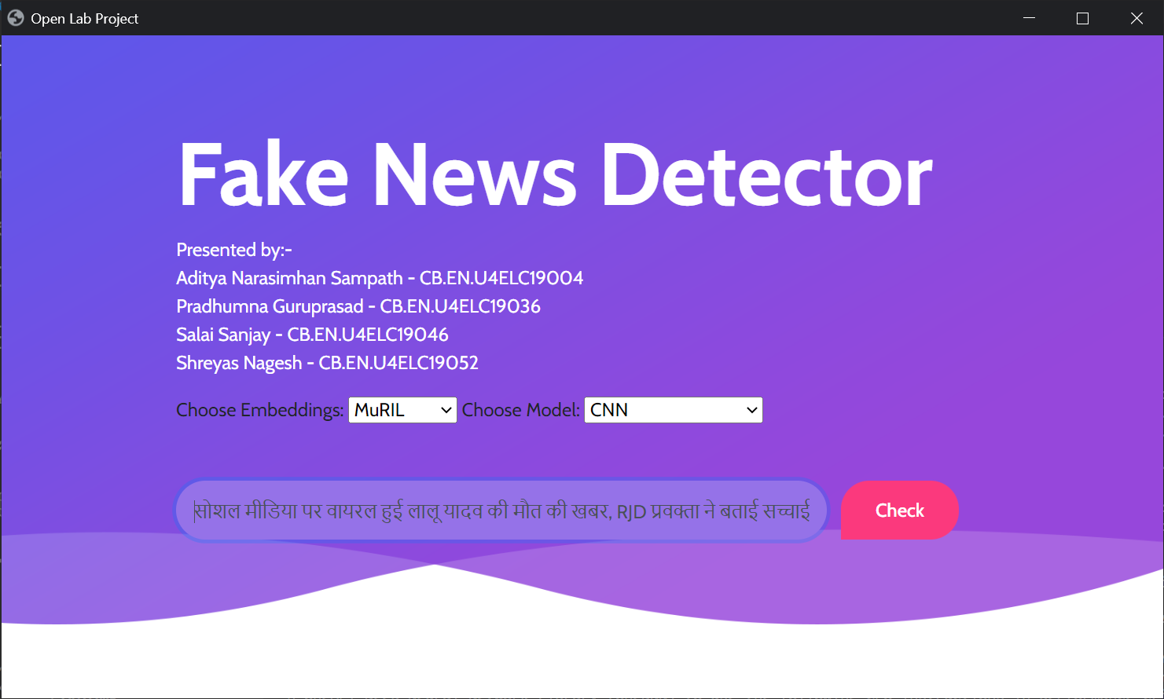
Introduction
This project aims to predict whether the Hindi news entered by the user is fake or not. The application uses an ML model trained on around 5000 news articles taken from various websites.
The application has a user-friendly GUI in which the user can input the news article to be checked for and the application predicts with a 97% accuracy whether the news is true or fake.

Slide 3

Application Areas
Fake news is becoming more prevalent with the advent of easy access to social media. This is a serious problem which needs to be tackled, so that people can differentiate between the truth and lies.
This software can be easily installed on any PC and all the user needs to do is enter the news article and it will return whether the news is true or not.

Slide 4
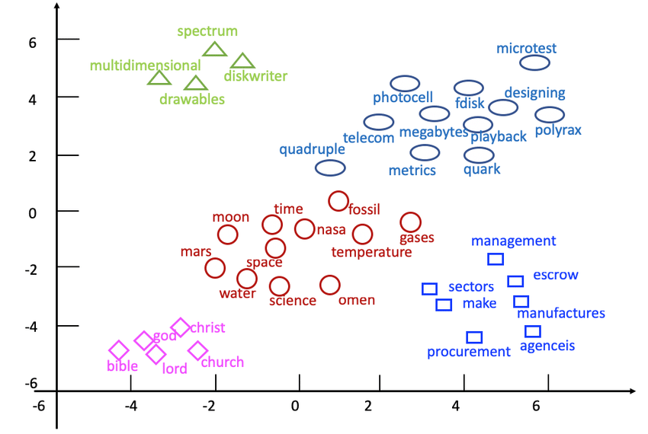
Libraries and algorithms
Since our project deals with Hindi data, the libraries and algorithms slightly vary from the ones used standardly in English.
For generating word embeddings, we used –
IndicBERT
MuRIL
For making predictions, we used 3 ML techniques –
Logistic Regression
SVM
CNN

Slide 5
Methodology
First, a dataset of around 5000 news articles from different websites was collected. This news was labelled based on the fact check provided in the websites.
Next, the data had to be cleaned. This was done by first tokenising, removing stopwords and punctuations and then lemmatizing.
Then the data is passed to IndicBERT and MuRIL to generate word embeddings. This vector of numbers is what is passed to the ML algorithms to work with.
The ML algorithms – CNN, logistic regression, SVM are trained on these word embedding vectors and their respective labels.
To predict whether the user’s data is true or fake we perform the above steps and run the trained ML model on the word embeddings. This model returns the predicted output.

Slide 6
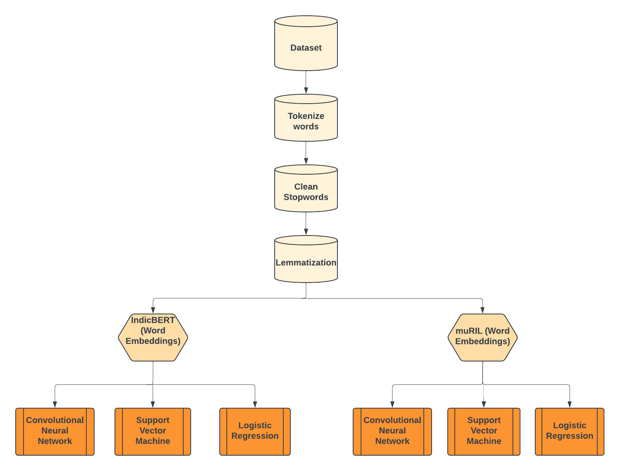
Block diagram

Slide 7
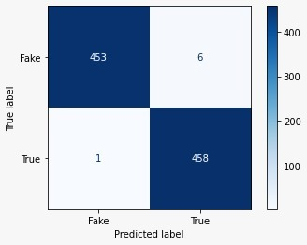
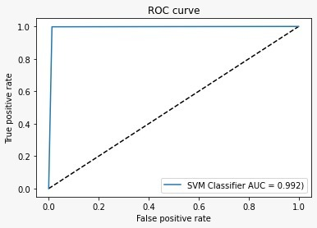
Accuracy
 | IndicBERT | MuRIL
SVM | 97.6% | 98.69%
Logistic Regression | 98.15% | 98.04%
CNN | 96.29% | 97.82%

Slide 8
Challenges faced
Since not much literature and libraries are present for Indian languages, we faced issues in data cleaning and generating word embeddings.
The libraries present now are not fully developed yet and are still undergoing big changes. Also, literature on how to use it is still primitive.
Each library outputs its data in a different format, therefore, normalizing all of them to feed it to the ML models was also a tedious task

Slide 9
Future Scope
This can be extended to other regional languages which have decent NLP support. The cleaning and pre-processing steps might be different since the syntax for each language varies.
The dataset can be made more complete, by manually verifying that the labels for all the news articles are correct. This will be more accurate in the real world.

Slide 10
References
MuRIL - https://huggingface.co/google/muril-base-cased#:~:text=MuRIL%20is%20a%20BERT%20model,word%20predictions)%20in%20this%20repository.
IndicBERT - https://indicnlp.ai4bharat.org/indic-bert/
Stanza - https://stanfordnlp.github.io/stanza/
https://theconversation.com/why-science-matters-so-much-in-the-era-of-fake-news-and-fallacies-113298

Slide 11

Thank You

